Slide 1
SMART FARMING SYSTEM
N SAI JAGADEESH (RA1911029010075)
P V S S POOJITH (RA1911029010098)

Slide 2
INTRODUCTION
1)India's population crossing 1.3 billion in 2016.
2)So balance between the optimum population growth and a healthy of nation is far to be achieved.
3)The rising population need for increased agricultural production
4)Irrigated agriculture has been important source increased agricultural production
5) "IOT based smart irrigation system" is for to create an IOT base automated irrigation mechanism which turns the pumping motor ON and OFF pass command through IOT platform.

Slide 3
IOT
1)The Internet of Things (IoT) is the inter-networking of "physical devices" also referred to as "connected devices" and "smart devices“
2) Sometimes referred to as the Internet of Everything (loE) and Machine to Machine (M2M) communicating.
3)IOT is expected to offer advanced connectivity of devices, systems, and services that covers a variety of protocols, domains, and applications

Slide 4
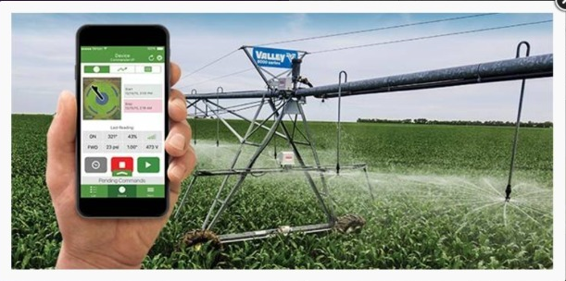

Slide 5
1) A device comprising of some sensor and microcontroller is programmed for operating motor in such a way that when soil moisture goes down motor get on automatically, and after reaching a limit it gets off.
2) Now a days there is a huge shortage of water, many places in India facing problem, this system could be helpful as it save water comparing to traditional way.

Slide 6
1)In this project I have made a working prototype model, using home gateway, sensor, relay module and motor, the programming is done on cisco packetTracer. All the system is integrated in such a way that it monitors water levels as well
2) The water in soil (or) field is sensed by sensor node and the sensed data is sent to microcontroller node through wireless networking .the limits we set in sensor as it works when the water level is less than 5 .
3) In comparisons after monitoring for alternate 4 days in traditional way and smart irrigation we analysed the reduction of water wastage was nearly 33% compared to traditional way.

Slide 7
SOFTWARE REQUIRED :
1)Packet Tracer is a cross-platform visual simulation tool designed by Cisco Systems that allows users to create network topologies and imitate modern computer networks
2) Cloud website: the cloud website which is used is Thing Speak. The farmer can see all the data updates on this site, by just clicking the channel link. Details can be seen on
3)HARDWARE USED :
HOME GATEWAY - The cisco packet tracer interface provides inbuilt devices to be added in the network. The first step is to select home gateway device from the network devices. To authenticate and validate the wireless connection, we also can configure home gateway with WEP/WPA-PSK /WPA2 protocols
Water level monitor - Used to detect water level of home environment
Lawn sprinkler - Used to sprinkler based on water level of the environment

Slide 8
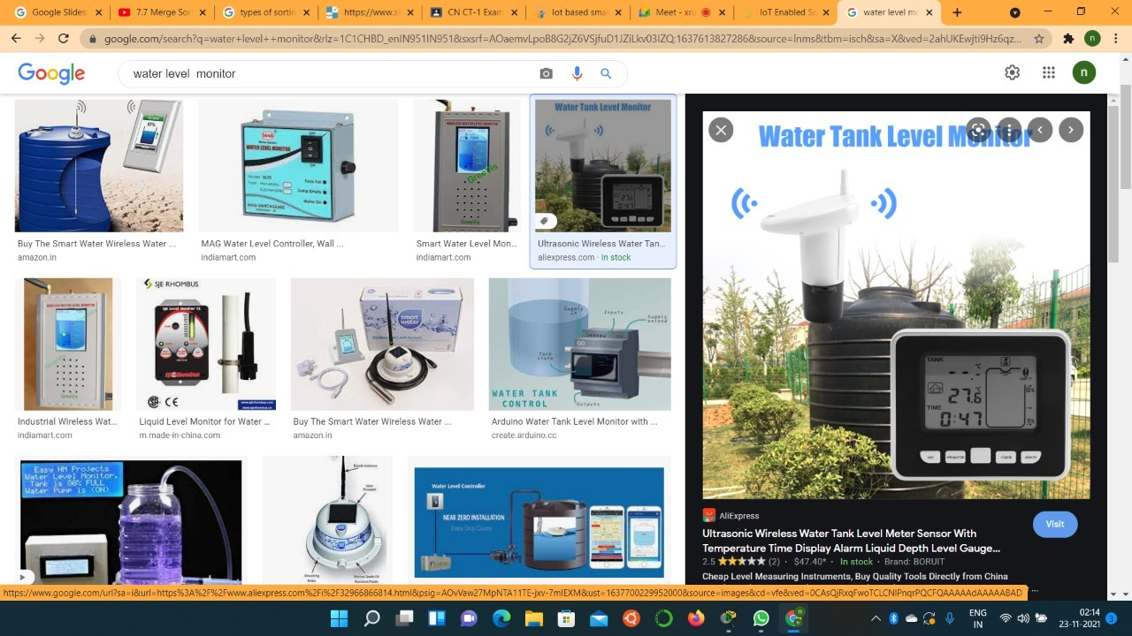
Water Level Monitor

Slide 9
WATER LEVEL MONITOR(SPECIFICATONS)
A Level Monitor that measuresthe amount of water ininch/cm .
Features Registration Server Compatible Water level detection
Usage Water Level Monitor works with Environment object; It reads WATER_LEVEL set in the Environment object .
Direct Control
N/A
Local Control
Environment object controls the WATER_LEVEL value being captured
Remote Control
Connect device to Registration Server using Config Tab
Data Specifications:
Message
Format: [level]level: any output >= 0
Example: Use water_level_monitor.pkt sample file

Slide 10
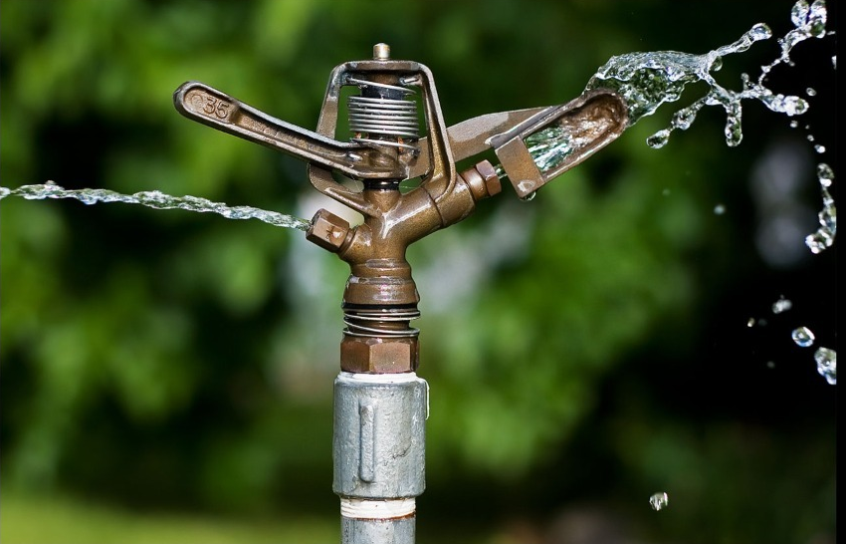
SPRINKLER

Slide 11
Lawn Sprinkler(specification)
A Sprinkler for Lawn.Features:
Registration Server Compatible
Raises the water level
Usage:
N/A
Direct Control:
ALT-Click to interact
Local Control:
Connect device to MCU/SBC/Thing. Use the "customWrite" API per Data Specifications
.Remote Control
:Connect device to Registration Server using Config Tab
Data Specifications:
Input Slot:
D0Message
Format: [state]state: 0 = off, 1 = on
Example:Look for IoT sample named lawn_sprinkler.pkt.

Slide 12
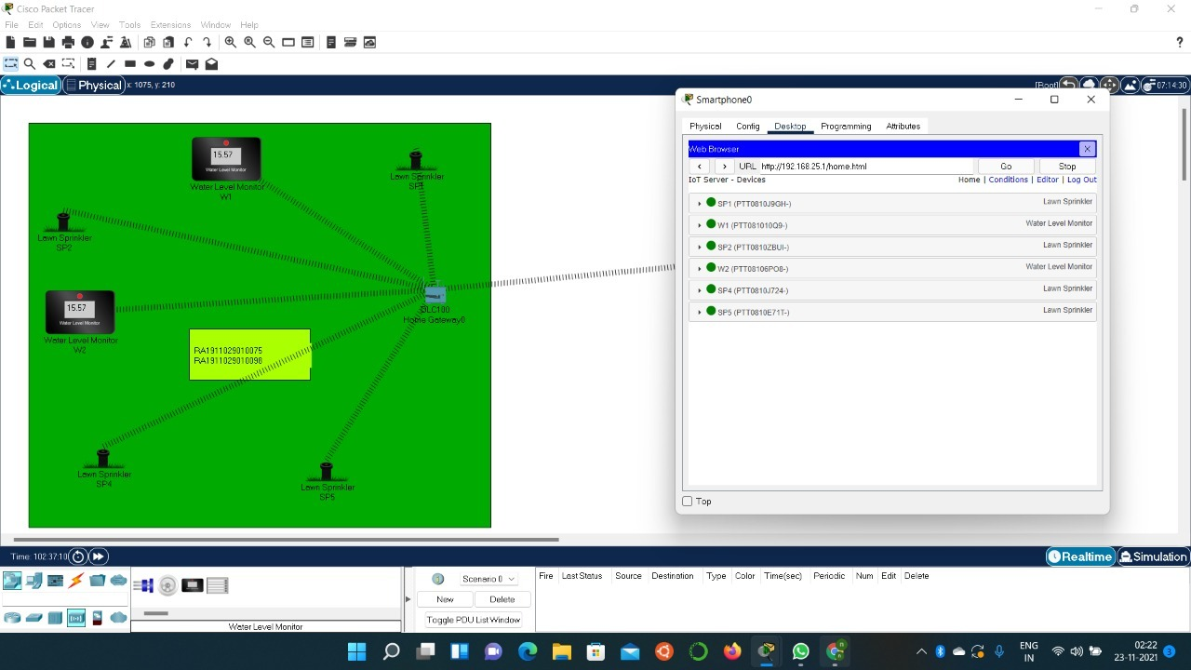
CELLPHONE AND ITS CONFIGURATION

Slide 13
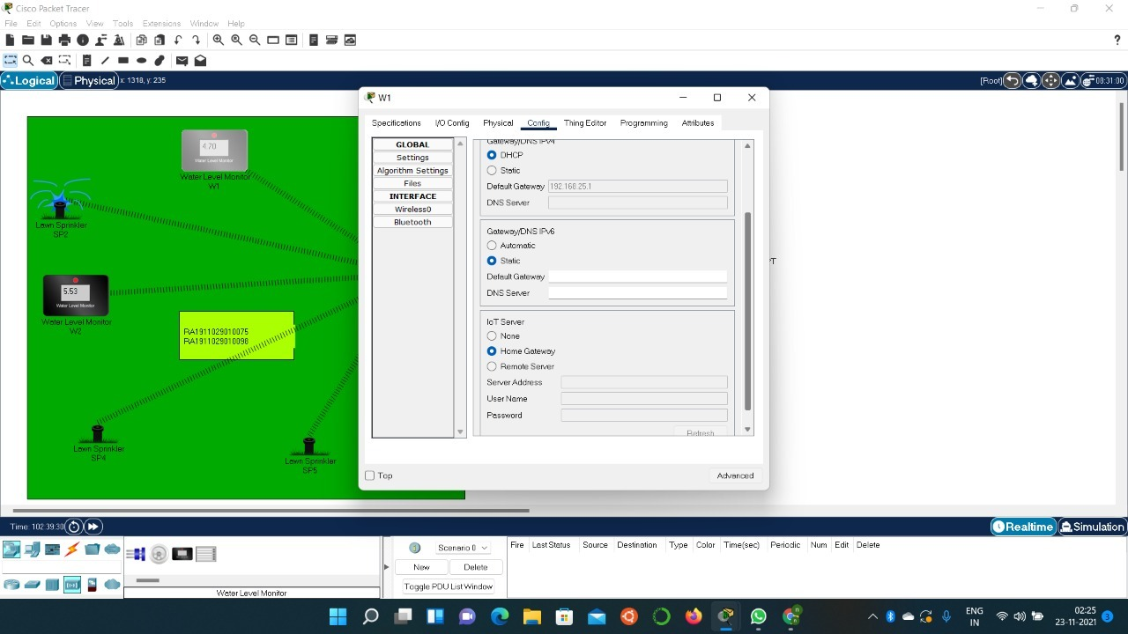
ALL WATER LEVEL MONITOR AND SPRINKLERS ARE SET TO BE IN HOME GATEWAY

Slide 14
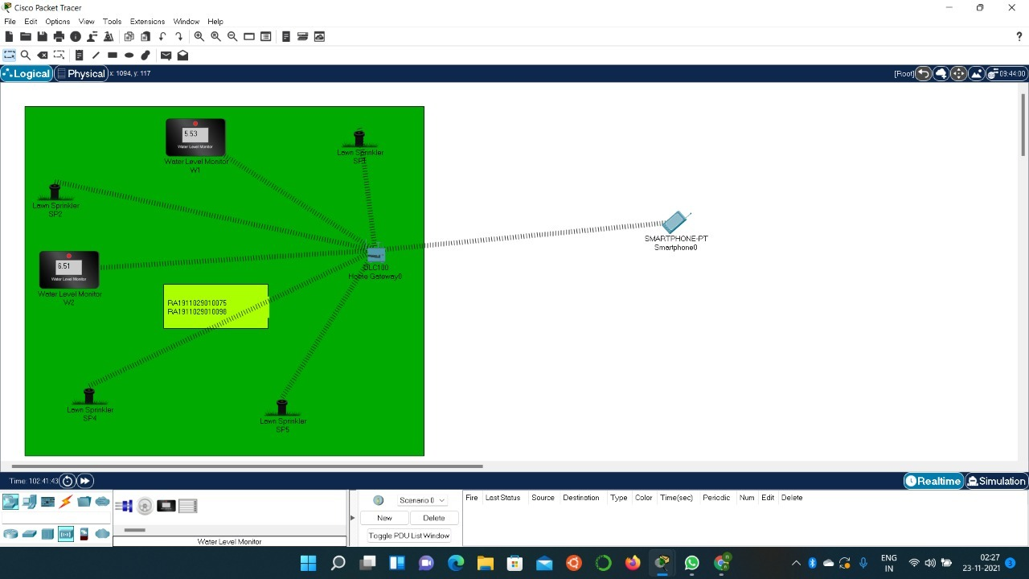
OUTPUT: when water level is more than 5 sprinklers wont work

Slide 15

when water level is less than 5 sprinklers will works

